Slide 1
Can “Dumb” beat “smart”? On Access channel design for mobile IoT
Shu wang, ph.d.

Slide 2
Are more prior information and more aggressive computation the necessary ingredients for achieving optimal performance?
If No, how?
Is the resource competition between existing mobile network services and the emerging IoT services a zero-sum game?
If Yes, how?

Slide 3
summary
In Network Engineering, access channel capacities are traditionally viewed as a function of timing (Smartness I) and power control (Smartness II)
Aloha vs. Slotted Aloha
In Information Theory, however, an optimal capacity is achievable through power control (Smartness II) and interference cancellation (Smartness III & Diligence).
The perfect timing information (Smartness I) may not be necessary; However,
the hardworking (Diligence) by the receiver is necessary, per multiuser receiver theory.
The proposed approach suggests the optimal throughput can be achievable through:
Extended low power access or transmission. (Dumbness)
Rapid Acknowledgement (aka, Early Termination).

Slide 4
outline
Background
Aloha access channel model
Mobile IoT (internet of things)
What Are The Problems?
IoT’s impact to existing mobile networks
Access success rate
Optimal Solutions :
Smart & Short Access Probe
Dumb & Long Access Probe.
Other Considerations.

Slide 5
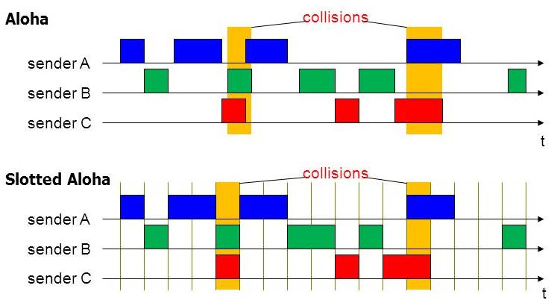
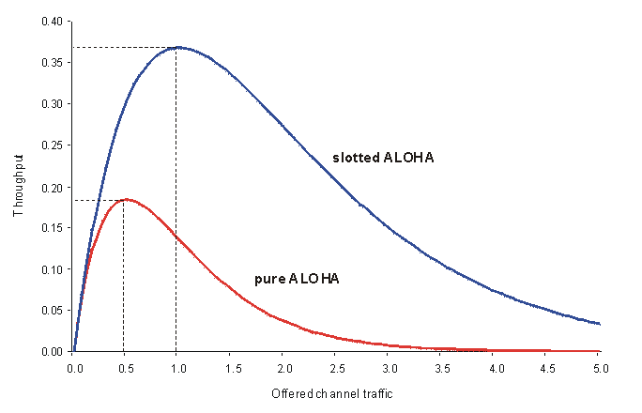
Background (1/3): Aloha channel model

Slide 6
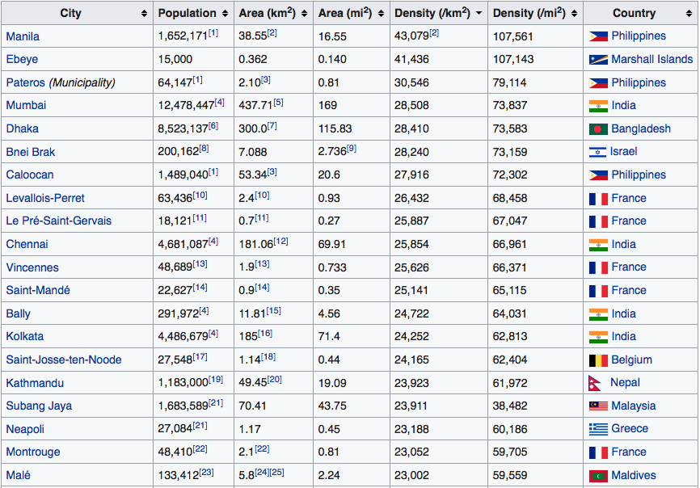
Background (2/3): Internet of things (IoT)
IoT networks are expected to connect billions of devices in the next several years.
One ambitious 5G requirement is to serve massive Internet of Things (IoT).
Obviously these requirements are highly expected for the IoT networks operated in high population density cities, where a large portion of IoT end-devices will be deployed.
For example, as shown in the table below, the population density in Chennai, India is 25,854 per Km².
If in average it is assumed that one IoT device per capita and the coverage of one IoT base station is 4 Km in radius, the number of the served IoT devices per base station is expected to be 25,854 x 3.14 x 16 = 1,298,905.
This means, considering a 30-minute period and assuming that there is no retransmission in a 4 km IoT network deployed in Chennai, India, the expected access capacity is 1,298,905 access per 30 minutes.

Slide 7
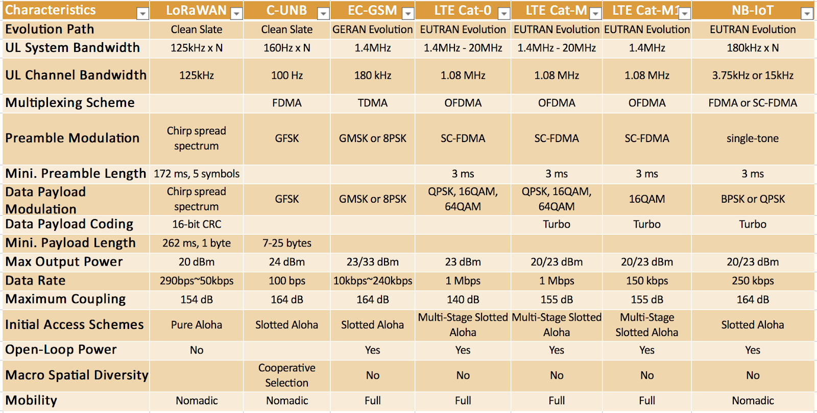
Background (2/3): Mobile IoT

Slide 8
The problems (1/2)
It has been established that the challenges to the existing mobile network services include
RoT (Rise over Thermal) increase: the RoT contribution from IoT terminals
Interference/collision: the potential dimension limit of current UL channels.
Problem #1 for mobile network upgrade when IoT terminals are widely deployed in the near future is how to minimize the impact on the existing network services.
Known Solution 1, Channelization: minimizes the overlapping between legacy probes and IoT probes
Known Solution 2, Power Control: minimize the interference to legacy 1x services.
Problem #2 is to how to also improve IoT terminals access success rate without having visible impact to the existing network services.
Can Solving Problem #2 without compromising the solution to Problem #1?
Is the resource competition between the existing mobile network service and the emerging IoT services a zero-sum game?

Slide 9
The problems (2/2)
Other related problems include:
The macro-diversity and detection complexity dilemma
The network imbalance.
The load and throughput dilemma
Additional considerations are
Improve terminal battery life.
Improve network Positioning.

Slide 10
Answer to P1 (1/3): Dumb vs. smart
Very SMART & SHORT access probe.
“Smart” means the probe knows the access timing of others.
It always arrives inside some access gap and has little overlap with existing access probes.
In order to be smarter, an access probe need be shorter.
A short access length means high Tx power and data rate.
Very DUMB & LONG access probe.
“Dumb” means it has no timing information of other probes.
For exploring access gaps, each probe is very long instead.
Long probe usually means low Tx power, low data rate and more diversity opportunities possible.
Low data rate means more redundancy and protection.
Coding gain and processing gain v.s. Tx Power

Slide 11
Answer to P1 (2/3): Power Control vs. timing
For Smart Probes, Smartness is the key and
From a network engineering perspective, the access timing information is the key for collision free.
From an information theory perspective, the access power control is very important for practical implementation of interference cancellation to achieve interference mitigation.
For dumb probes, power control is the key.
The purpose of power control is to extend the transmission, compensating the processing delay between transmitter and receiver in addition to exploring the instant fluctuation of access channel capacity.

Slide 12
Answers to P1 (3/3): comparison
 | Smart Access Probe | Dumb Access Probe | Comments
Require perfect access Timing of other terminals | Yes | No | Different design starting points.
Require power control | Depends | Yes
Require early termination | No | Yes
Tx Power and Rate Requirement | High Power and High Rate | Low Power and Low Rate
Coding & Processing Gain | Low | High
Interference to Others | Strong and Short | Low and Extended
RoT Contribution | Short and Fast | Long and Slow
Time Diversity Gain | Low | High | including channel time diversity, imperfect OL-PC, and interference fluctuation, etc.
Implementation Friendliness | The “smart” part is hard to be implemented. The “short” part is easy to be implemented | Friendly & Easy

Slide 13
Traditional Thinking of Collision Avoidance

Slide 14
A New Thinking of Collision Avoidance

Slide 15
Early Termination on Long Probes
It is possible for an AP to successfully detect and decode dumb access probes much earlier before a IoT terminal finishes it transmission, due to
Imperfect Open-Loop Power Control.
Interference / RoT Fluctuation.
Channel Time Diversity
As soon as a BS successfully decodes one dumb access probe, it will send ACK in the earliest next paging cycle.
As soon as a IoT terminal successful receives ACK, it will immediately stop the transmission of the rest probe.
Early termination is possible due to the duration of dumb access probes can be more than one paging cycle.

Slide 16
Macro-Diversity on Long Probes
For achieving macro-diversity or soft handoff on RL access probe detection, more than one sectors will simultaneously monitor access probes.
As soon as one sector successfully detects one dumb access probe, it will
Report the access header and payload data to the serving BSC/PCF.
(optional) send ACK through its own paging channel.
If the terminal is monitoring the paging channels of both its serving and neighbor sectors, it will stop the transmission as soon as it receives an ACK through any forward link paging channel it monitors.
Due to network imbalance, it is possible that one of its neighbor sectors can successfully detect access probes much earlier than its serving sector.
Additional macro-diversity capability helps increase early termination granularity.

Slide 17
So … What About P2 ?
Problem #2: will a long and low power access probe design have a low access success rate?
Answer: NO.
ALOHA model suggests two things fundamentally affect access success rates
The Channel. e.g. path-loss, fading, timing and related protocols.
The Signal. e.g. power control, coding and modulation.
Access success rate is NOT determined by probe length.
Accurate timing information is hardly available.
Power control plays a key role in access channel performance.
Early termination is a well-understood and practical way for compensating imperfect power control.

